Slide 1
Where is my……?

Slide 2
Let’s finish your workbook (unit 3)!

Slide 3
【第十六週英語作業】
聽CD2第24-27首，每聽3遍請家長在認證表
上簽一次名。
2. 寫:完成英語習作P50~51，明天交。

Slide 4
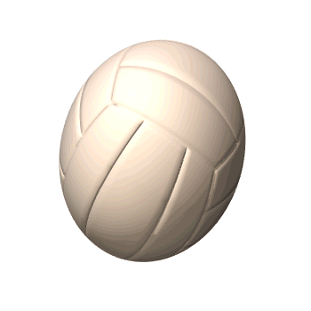
ball
a baseball
a pokéball
a basketball
a soccer ball
a volleyball

Slide 5
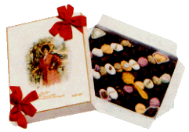
box
a candy box
a mail box
a gift box

Slide 6
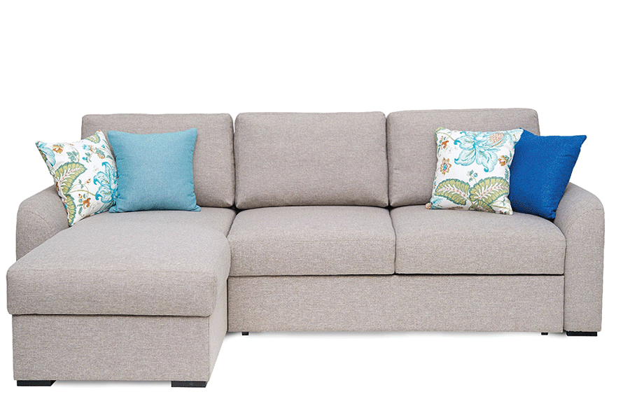
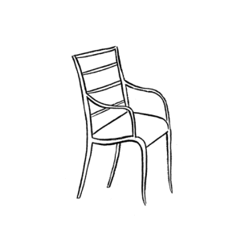
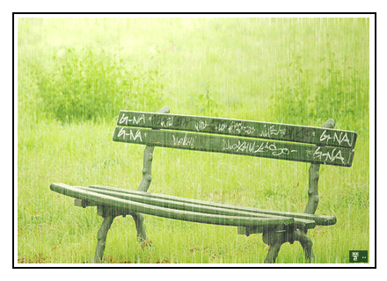
chair
a sofa
a bench

Slide 7
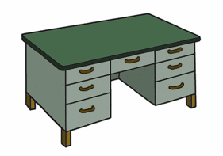
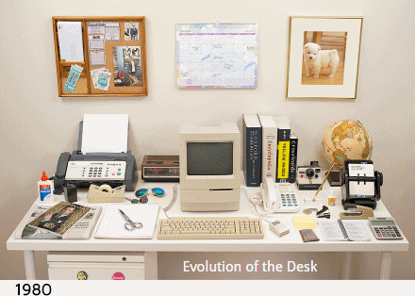
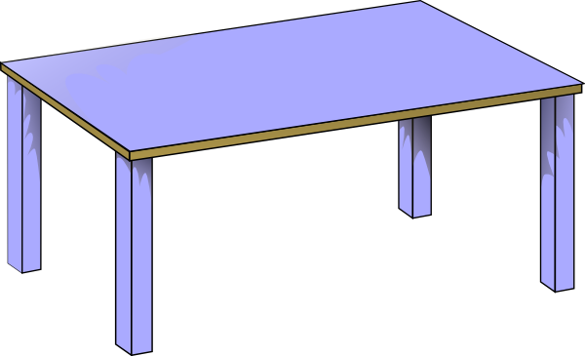
desk
a desk
a table

Slide 8
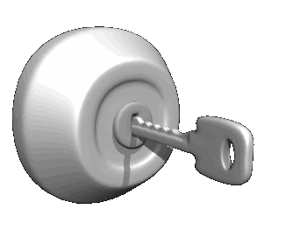
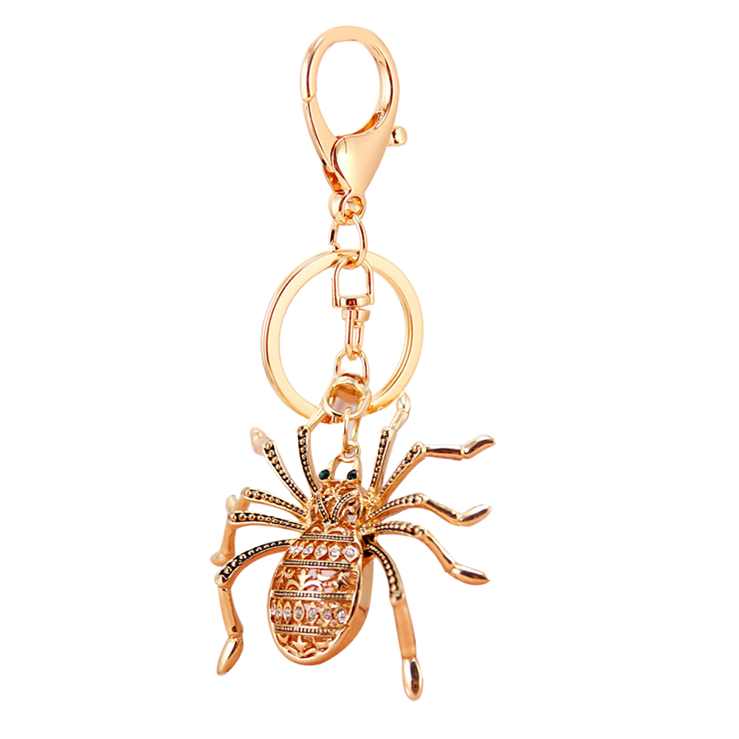
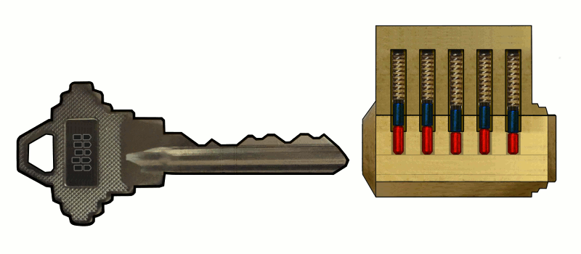
key
We can use the key to lock.
a key ring

Slide 9
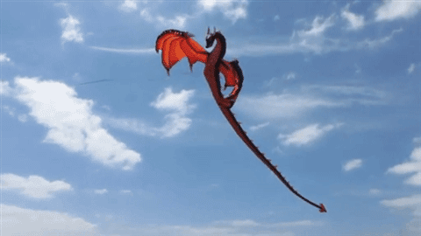
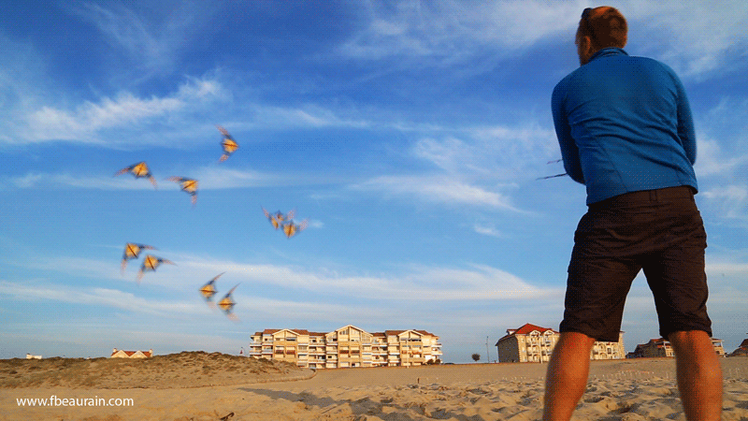
kite
fly a kite

Slide 10
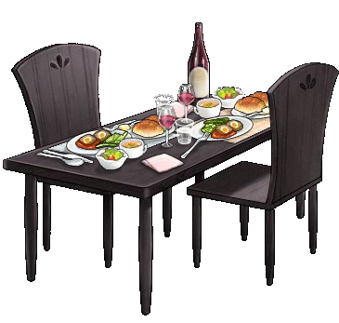
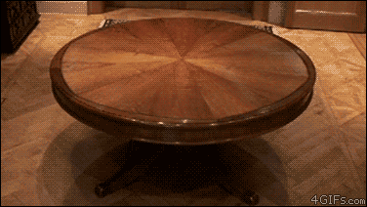
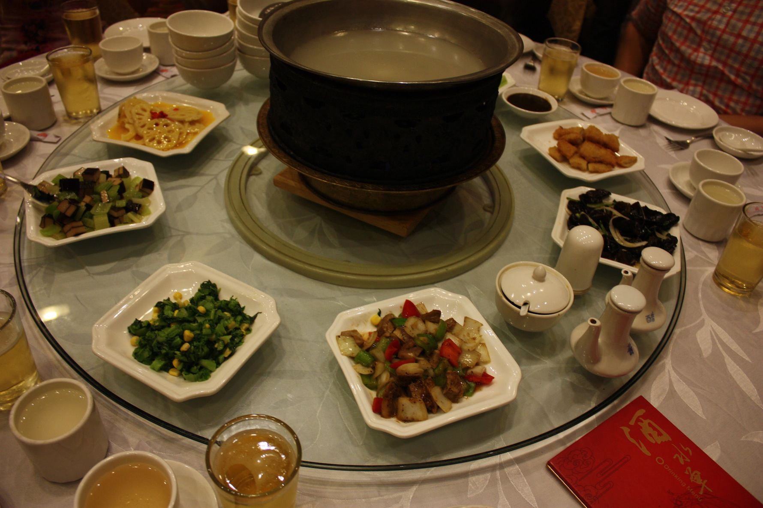
table
dining table
lazy Susan

Slide 11
a box
a ball
chairs
a key
a table
a kite
a desk

Slide 12
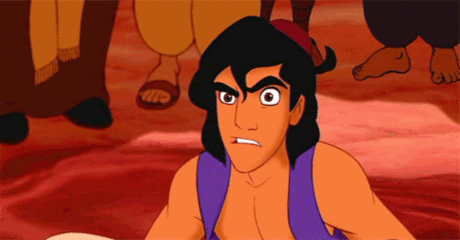
Take a guess. What’s this?

Slide 13
l
b
a
l

Slide 14
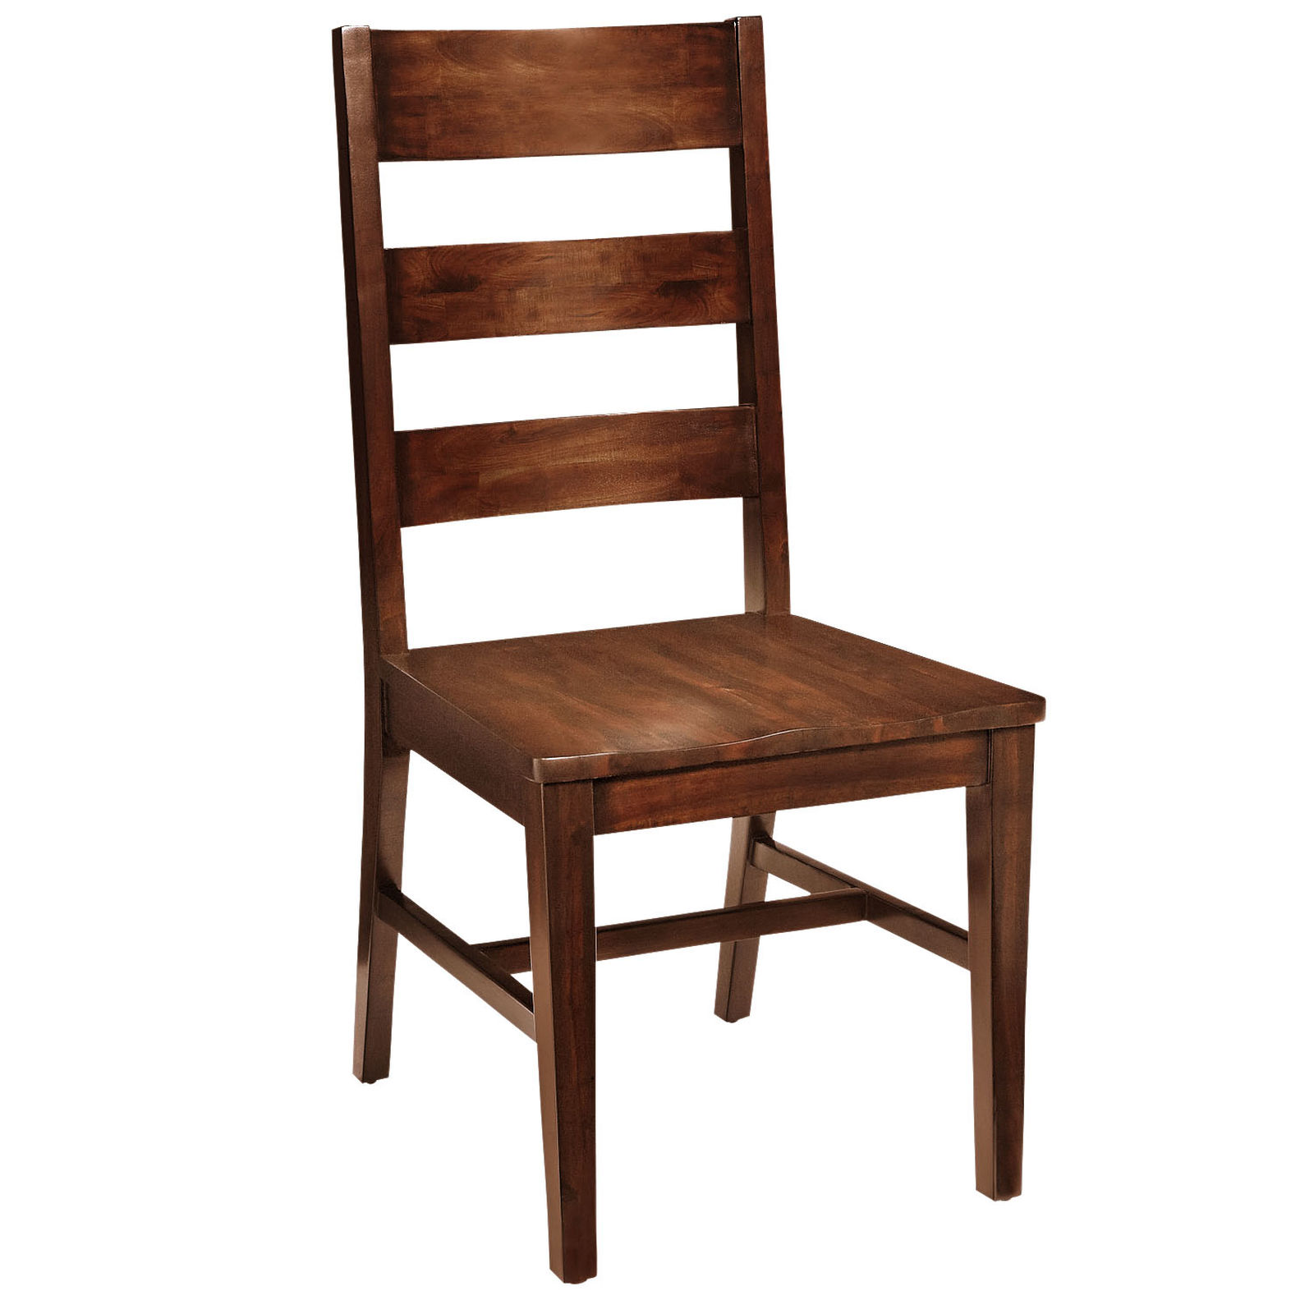
h
a
r
c
i

Slide 15
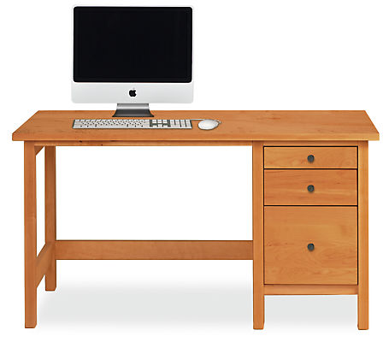
k
e
d
s

Slide 16
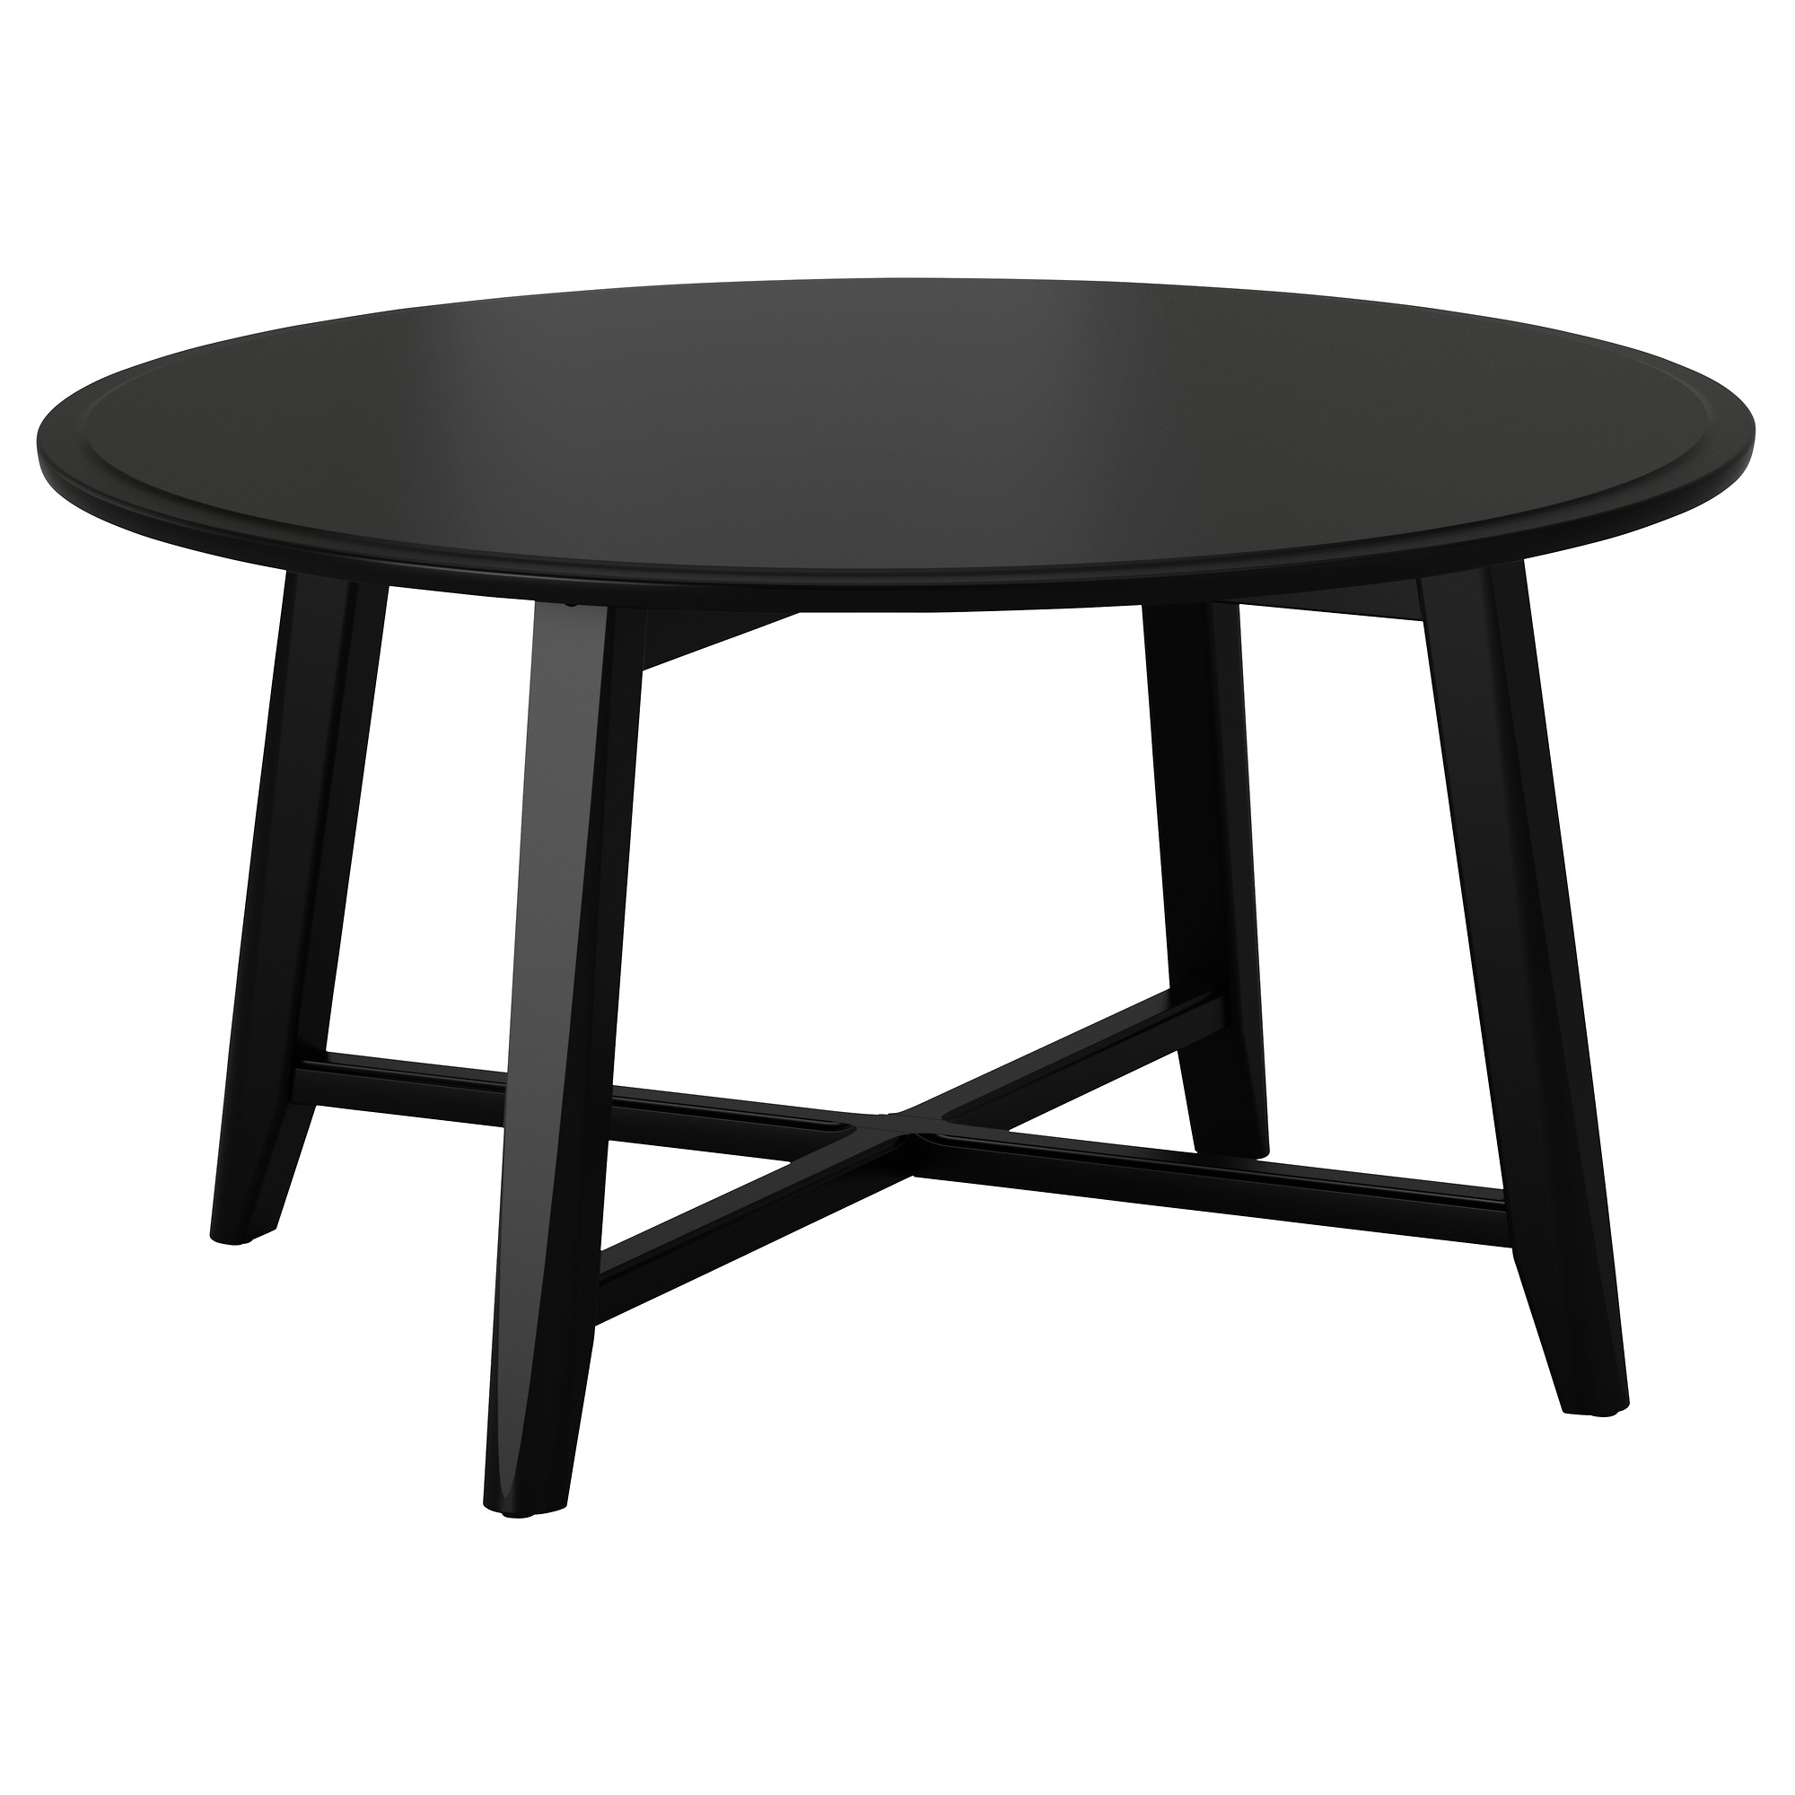
b
a
l
t
e

Slide 17
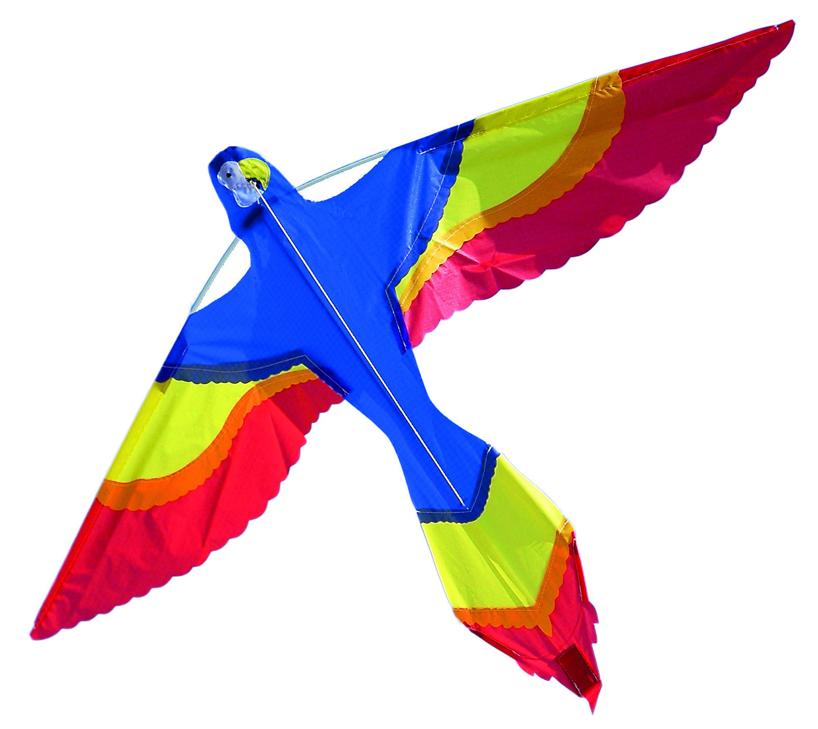
i
t
e
k

Slide 18
e
y
s
k

Slide 19
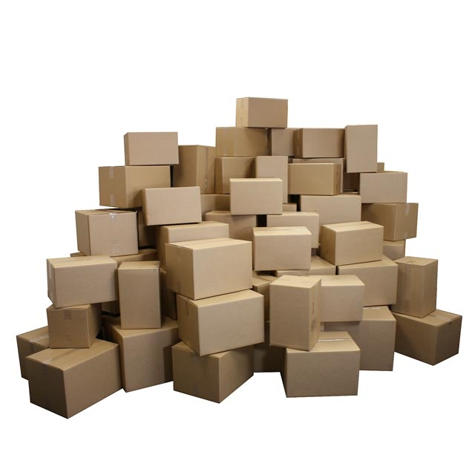
o
s
b
e
x

